Slide 1
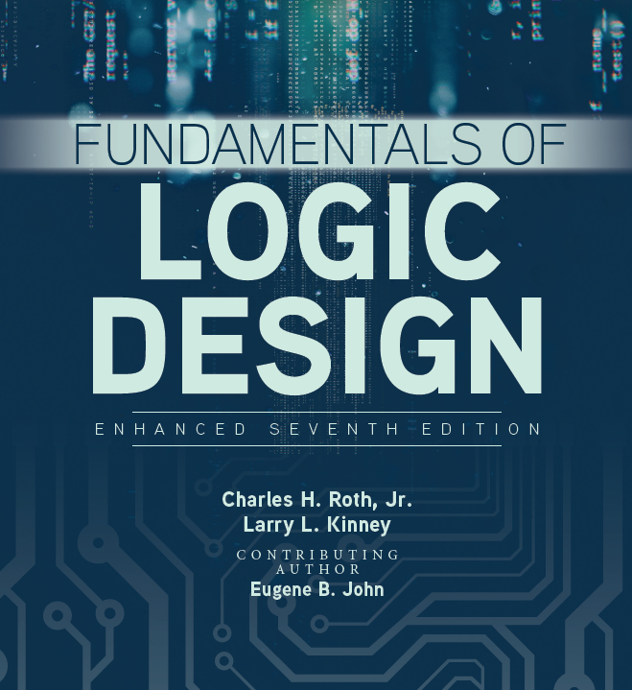

Sequential Circuit Design III

Slide 2
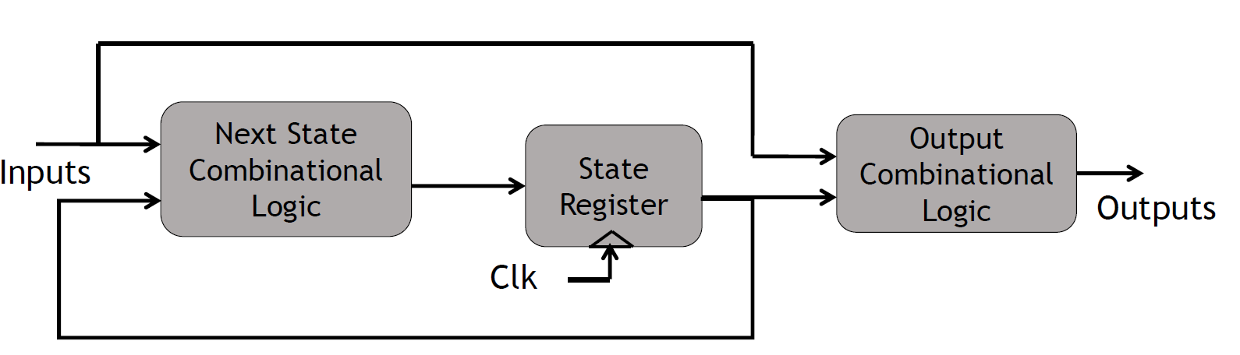

Mealy and Moore models
Two models of sequential circuits: Mealy and Moore
Mealy models: the output is a function of both present state and input
Also referred to as Mealy Finite State Machines (FSM)

Slide 3
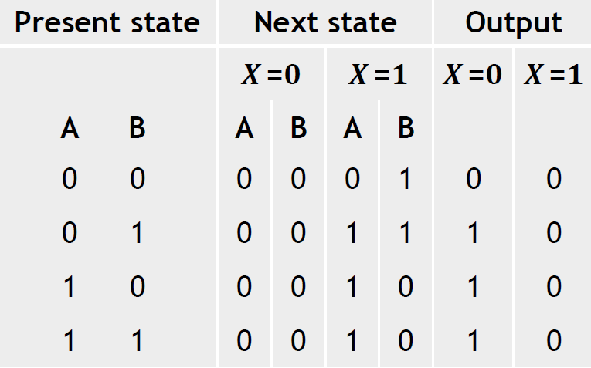
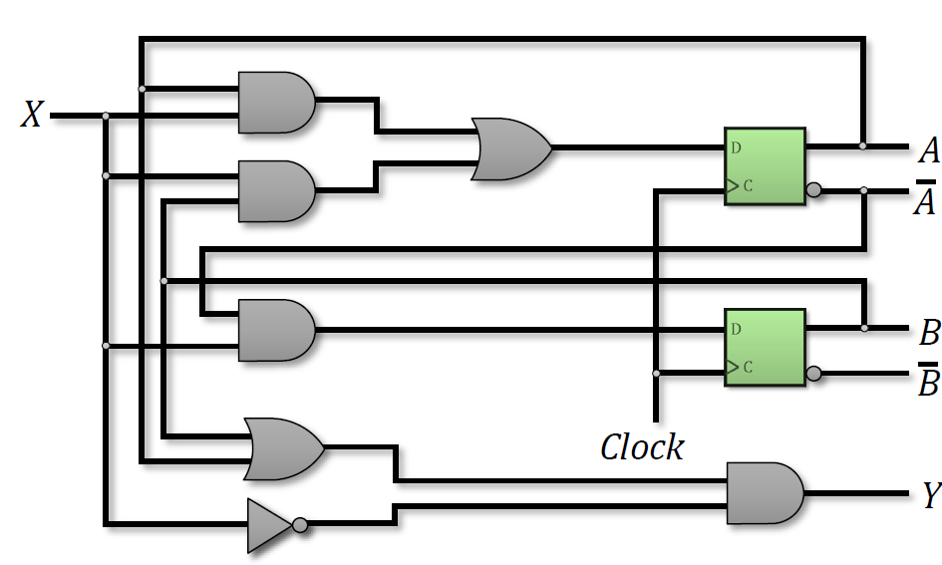
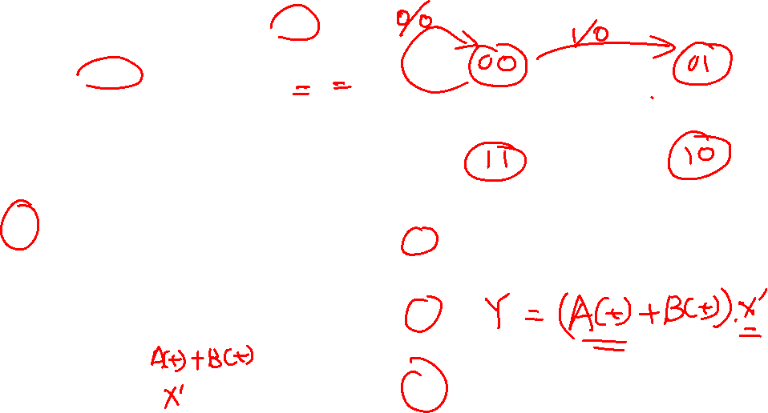
Mealy finite state machine
State diagram
Boolean expression for output

Slide 4
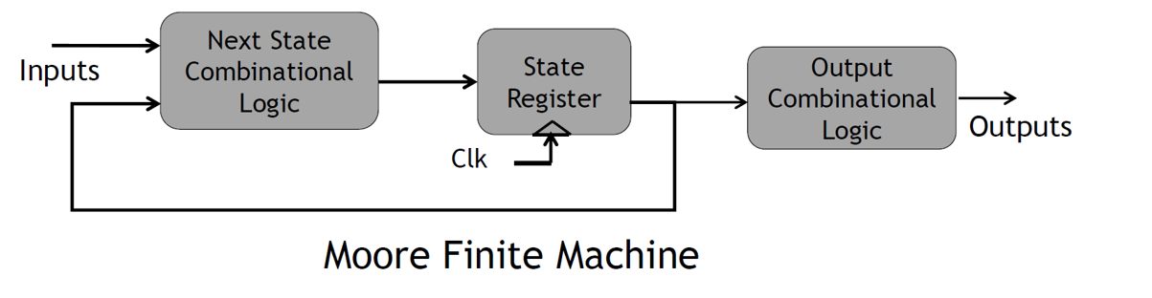

Moore model
Moore Model: the output is a function of only the present state
Also known as Moore Finite State Machine
State tables do not need separate output listing for various input combinations.
Output value is indicated inside the circle together with the present state.

Slide 5
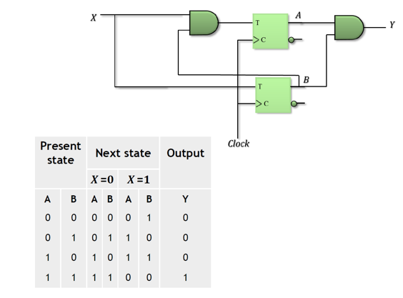
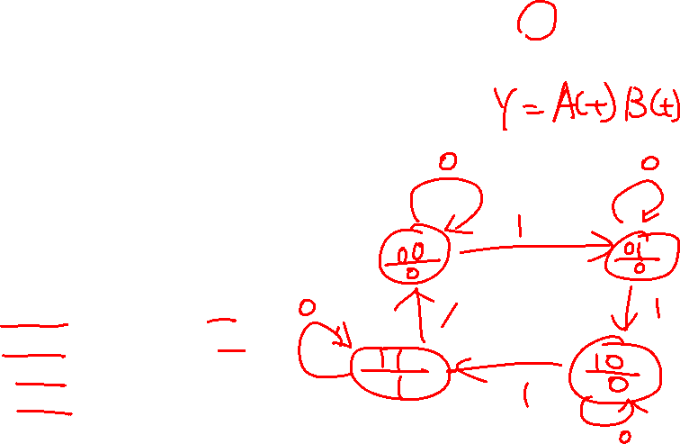
Moore finite state machine

Slide 6
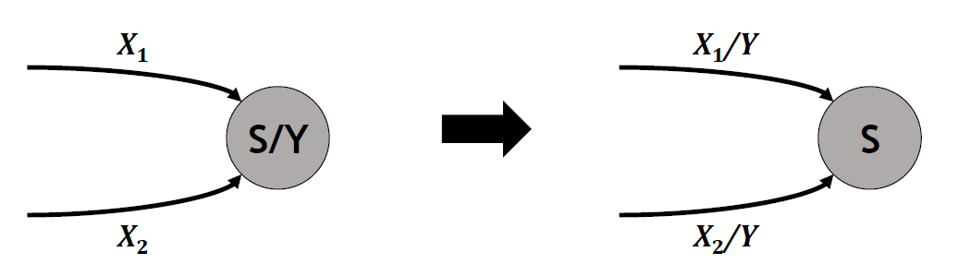
Moore to Mealy conversion
To convert a Moore machine to a Mealy one:
1.Pull the outputs back in all incoming transitions in the state diagram
2. Duplicate the outputs of any state to all occurrences of that state as a next-state in the state table

Slide 7
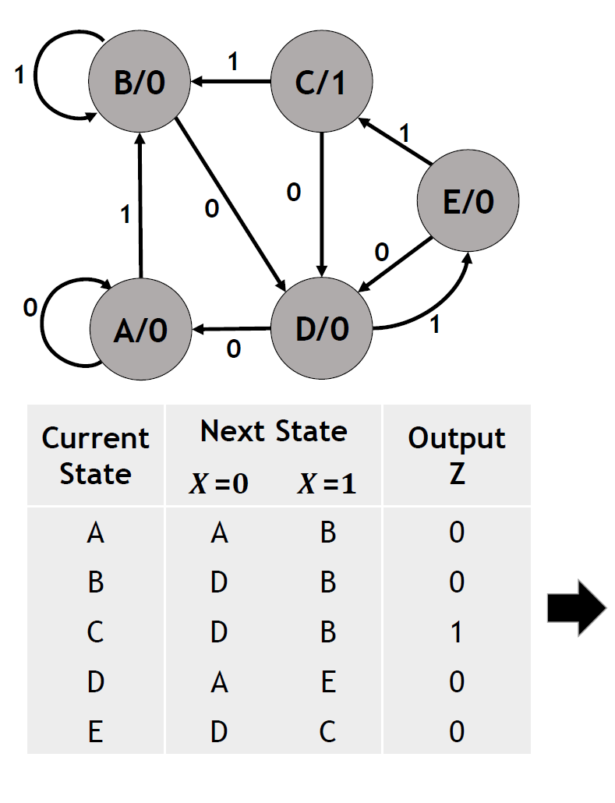
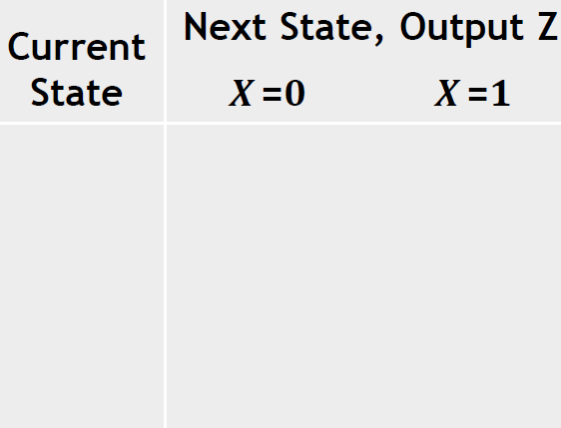
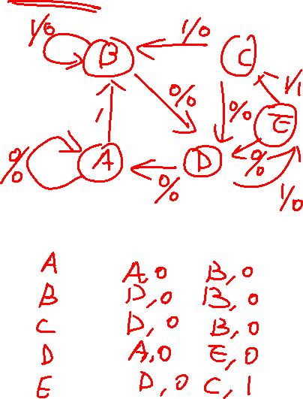
Moore to Mealy

Slide 8
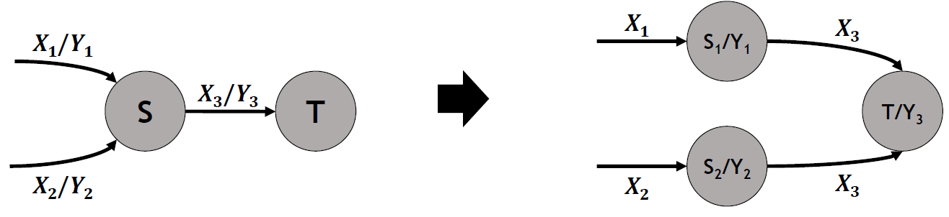
Mealy to Moore conversion
To convert a Mealy machine to a Moore one:
1.Split each state to the number of different outputs coming in, and push the outputs into the state in the state diagram
2.Create new states corresponding to all state-output combinations and fill in a new state table

Slide 9
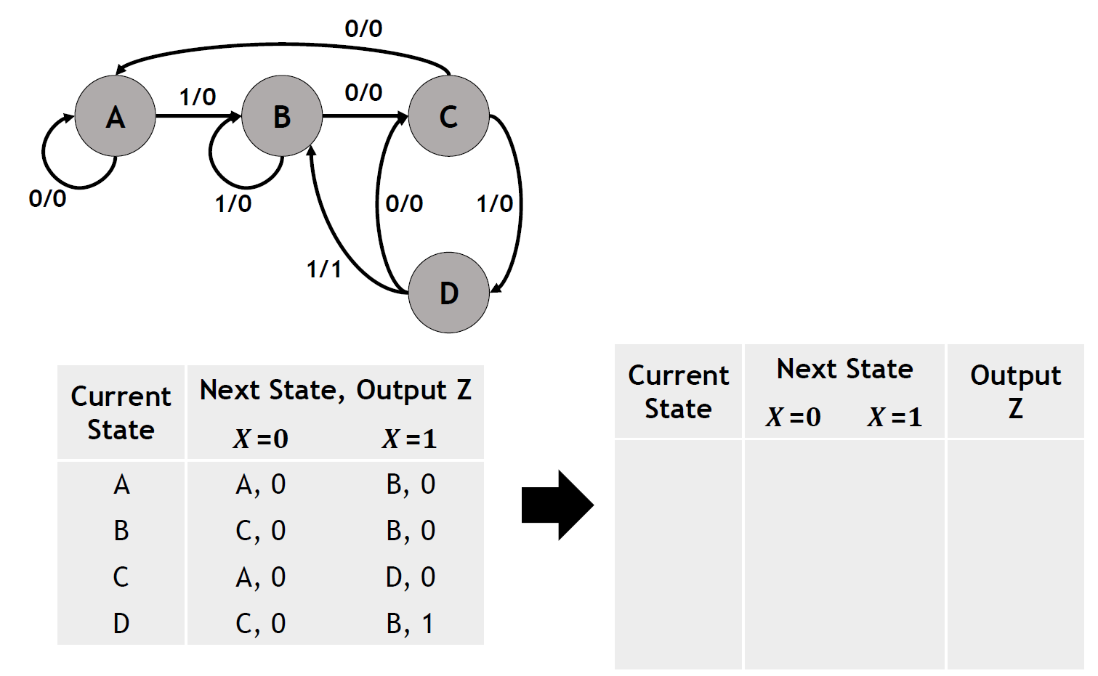
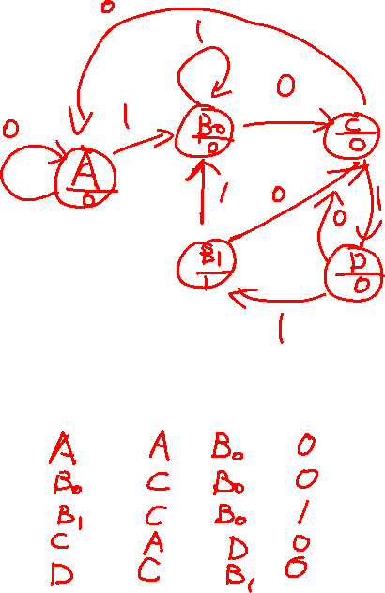
Mealy to Moore

